Slide 1

Ways to Survive
Presented by
Sophia Lopez, MPS
City of Bellevue Office of Emergency Management
&
Kayla Grayson, MPA
Bellevue College Public Safety Department
December 11th, 2015

Slide 2
Introductions
Who we are
What we do
  PREVENT, PREPARE, RESPOND, RECOVER, AND MITIGATE
Any first-hand experience you have had with a hazard or disaster.

Slide 3
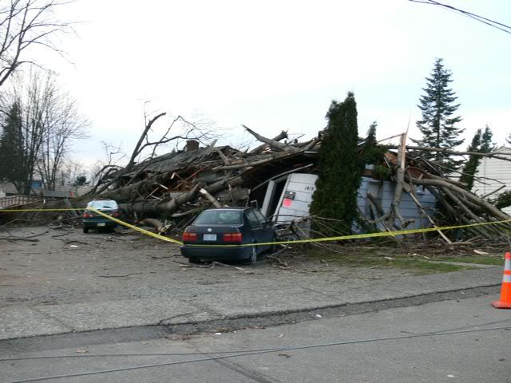
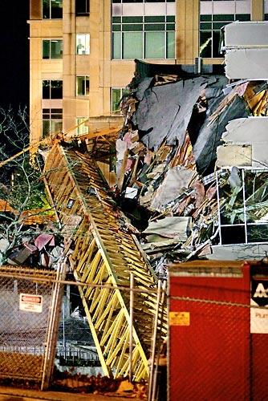
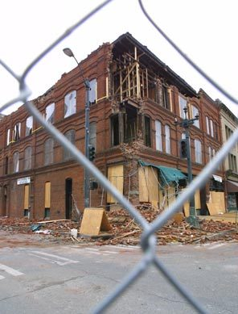
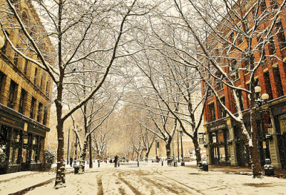
The Hazards We Share
Notes:
Snow & Ice: “Snowmageddon” of 2008
Heavy rain & floods: Self-explanatory
Wind: Hanukkahs Eve Windstorm of 2006
Earthquake: Nisqually, 2001
Tsunami: Hasn’t happened here...but we are near the ocean, and if you’re on vacation on the Coast, it’s a big deal
Extreme Heat: Heatwave of 2009; people were going to malls as cooling centers
Accidents or Things We Can’t Predict:
Bellevue Crane Accident of 2006
Anacortes Tesoro Oil Refinery accident

Slide 4
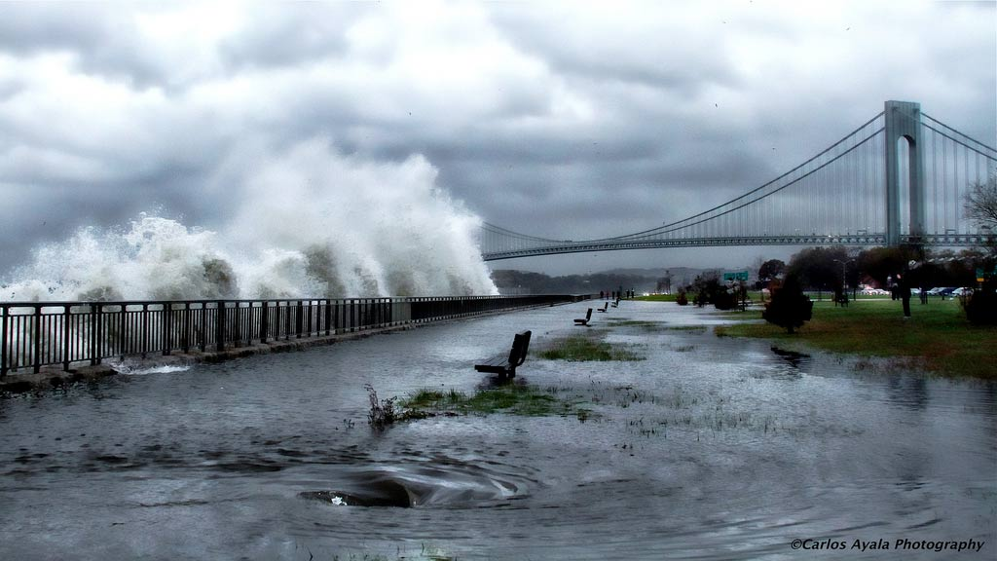
Why Disasters Hit the Elderly Hard
About two weeks after Hurricane Sandy hit in 2012, the New York Times reported that close to half of those who died in the storm were 65 or older. Many of these elderly victims drowned at home; others died from storm-related injuries, hypothermia and other causes.

Slide 5
Why are the elderly so disproportionately impacted?
Brainstorm some factors associated with the aging process that might affect an older adult’s ability to respond in a crisis.
Notes:
Sensory, Physiological, and Cognitive Changes
Chronic Conditions
Risk of Trauma
Transportation
Limited Resources
Nutrition
Fraud and Abuse
Reliance on caretakers
Loss of Pets

Slide 6

The All-Hazard Approach
Planning
Preparation
Partnership

Slide 7
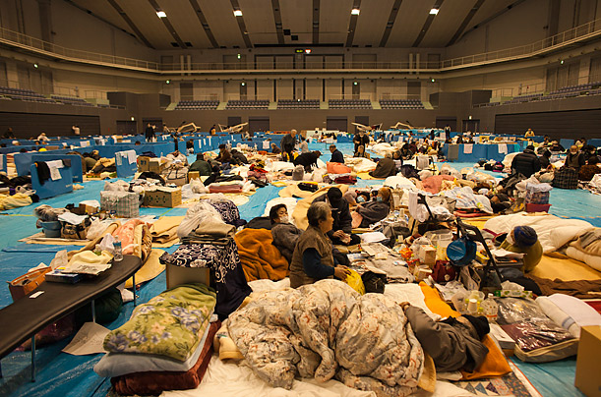
Plan
Communications
Evaluate your surroundings
Decide to stay or change locations
    Critical early decision in disasters
Think of all scenarios

Slide 8
Planning
Think of all scenarios: Where will you be?
Will you be at school, on the bus, or at home?
Evaluate your surroundings:
  House, workplace, school, frequent places
Communication with your family:
  Contact numbers listed other than your phone
  Out of area contact (At least 2)
Special needs that can be impacted?
Notes:
Think of all scenarios:
Where will you be? Where will your family be at any time? Do you have special needs that would be impacted if every day life activities halted?
Evaluate your surroundings:
Your house, workplace, or school could be a hazard. What things exist there that could hurt you? Can you name a few things?
Communications: Do you have plan on how to communicate with your family in case of an emergency? Do you have the contact numbers listed other than your phone?
Out of area contact. List 1-2 people who would be your out of area contact.

Slide 9
Develop a Disaster Plan
Where will you meet family members?
Who is your out-of-State “check-in” contact?
Will you have an extended stay? Shelter in place? Evacuate?
How will you escape your home? Workplace? Place of worship? Places you volunteer?
What route (and several alternates) will you use to evacuate your neighborhood?
Do you have transportation or need help with transportation?
Did you practice your plan?

Slide 10
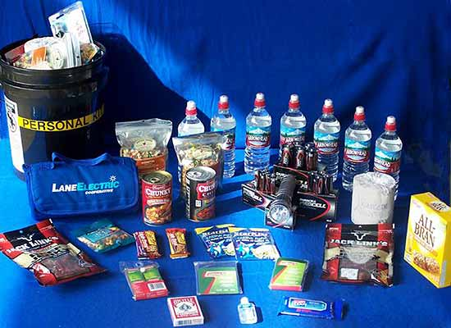
Preparation
Food
Water
Heat
Other items

Slide 11
What items do you need in your kit?

Slide 12
Preparation
Basic Home Kit:
Water: 1 gallon per person per day (7-10 days)
Food: Supply of easy non-perishable food items, dietary requirements, baby food, pet food, food packets , dietary requirements
Cash (Small bills; ATMs may not be working or accessible)
Warmth: Clothes, coats, boots, sturdy shoes & blankets, scarves, gloves
Notes:
Water: 1 gallon per person per day
Warmth: Clothes & blankets, sleeping paraphernalia
Food: You can buy food packets, can goods, easy non-perishable food items. But if you’re like me, I’m a snacker and I keep stuff around that I normally eat when it’s an “emergency dinner” Keep in mind special diets: Allergies, Cholesterol, dialysis, gluten free, vegan…
Other items: Meds, glasses, tools, whatever else you might need to make you feel comfortable. So dependent on personal preference and lifestyle.

Slide 13
Preparation
Basic Car Kit:
Jumper cables
Flashlights
First Aid Kit
Food
Manual can opener
Water
Basic toolkit
Pet supplies
Radio: battery or hand cranked
Cat litter or sand: for better tire traction
Shovel
Ice scraper
Clothes
Blankets or sleeping bags
Phone Charger
Notes:
In case you are stranded, keep a kit of emergency supplies in your car including:
Jumper cables: might want to include flares or reflective triangle
Flashlights: with extra batteries
First Aid Kit: remember any necessary medications, baby formula and diapers if you have a small child
Food: non-perishable food such as canned food, and protein rich foods like nuts and energy bars
Manual can opener
Water: at least 1 gallon of water per person a day for at least 3 days
Basic toolkit: pliers, wrench, screwdriver
Pet supplies: food and water
Radio: battery or hand cranked
Cat litter or sand: for better tire traction
Shovel
Ice scraper
Clothes: warm clothes, gloves, hat, sturdy boots, jacket and an extra change of clothes for the cold
Blankets or sleeping bags
Charged Cell Phone: and car charger

Slide 14
Preparation
Other Important Items to consider:
Candles
Garbage bags
Pen & paper/notepad
Utility shut-off tools
Filter masks
Whistle
Matches
*Create the same portable kit for your car and your office.

Slide 15
Preparation
Special needs:
  Medications (list with dosage and frequency)
  Allergies
  Cholesterol
  Dialysis
  Spare glasses
  Hearing Aids
  Map
  Teddy bears
  Book
Notes:
Other items: Meds, glasses, tools, whatever else you might need to make you feel comfortable. So dependent on personal preference and lifestyle.
Fun stuff: Bottle of wine, chocolate, teddy bears…

Slide 16
Preparation
Documents & Copies:
  Passport
  Driver’s license
  Birth certificate
  Green card
  List of contact numbers
  Pictures of family members and pets
  Others you can think of…

Slide 17
Preparation - Pets
Make A Pet Emergency Plan
  ID your pet. Have a current photo of your pet.
  Make a pet emergency kit. Check out this quick list:
    Pet food
    Bottled water
    Medications
    Veterinary records
    Cat litter/pan
    Manual can opener
    Food dishes
    First aid kit and other supplies
  Identify shelters. www.gopetfriendly.com
Notes:
ID your pet: Make sure your pet’s tags are up-to-date and securely fastened to your pet's collar. If possible, attach the address and/or phone number of your evacuation site. If your pet gets lost, his tag is his ticket home. Also consider microchipping your pets.
Have a current photo of your pet for identification purposes.
Go to Ready.gov for a full list of items to include in your pets kit.
For public health reasons, many emergency shelters cannot accept pets. Find out which motels and hotels in the area you plan to evacuate to allow pets well in advance of needing them at www.gopetfriendly.com. There are also a number of guides that list hotels/motels that permit pets and could serve as a starting point. Include your local animal shelter's number in your list of emergency numbers.
Make sure you have a secure pet carrier, leash or harness for your pet so that if he panics, he can't escape.

Slide 18
Preparation - Pets
Prepare Shelter For Your Pet
  Local emergency management office, animal shelter or animal control office
  If you are unable to return to your home right away, you may need to board your pet.
  Leaving your pet at home puts them in danger but if you have no alternative, there are some precautions you must take:
    Confine your pet to a safe area inside - NEVER leave your pet chained outside!
    Leave them loose inside your home with food and plenty of water.
    Place a notice outside in a visible area, advising what pets are in the house and where they are located.
    Provide a phone number where you or a contact can be reached as well as the name and number of your vet.
Notes:
Call your local emergency management office, animal shelter or animal control office to get advice and information.
If you are unable to return to your home right away, you may need to board your pet. Include copies of vaccinations in your "pet survival" kit along with a photo of your pet.
Find out where pet boarding facilities are located. Be sure to research some outside your local area in case local facilities close.
Most boarding kennels, veterinarians and animal shelters will need your pet's medical records to make sure all vaccinations are current. Include copies in your "pet survival" kit along with a photo of your pet.
Some animal shelters will provide temporary foster care for owned pets in times of disaster but this should be considered only as a last resort.
If you have no alternative but to leave your pet at home, there are some precautions you must take, but remember that leaving your pet at home alone can place your animal in great danger!
Confine your pet to a safe area inside - NEVER leave your pet chained outside!
Leave them loose inside your home with food and plenty of water. Remove the toilet tank lid, raise the seat and brace the bathroom door open so they can drink.
Place a notice outside in a visible area, advising what pets are in the house and where they are located.
Provide a phone number where you or a contact can be reached as well as the name and number of your vet

Slide 19
Preparation - Pets
Protect Your Pet During A Disaster
  Bring your pets inside immediately.
  Have newspapers on hand for sanitary purposes. Feed animals moist or canned food so they will need less water to drink.
  Separate dogs and cats.
  If you evacuate your home, DO NOT LEAVE YOUR PETS BEHIND!
  If you are going to a public shelter, it is important to understand that animals may not be allowed inside.
  Make a back-up emergency plan in case you can't care for your animals yourself.
Notes:
Bring your pets inside immediately. Animals have instincts about severe weather changes and will often isolate themselves if they are afraid. Bringing them inside early can stop them from running away. Never leave a pet outside or tied up during a storm.
Have newspapers on hand for sanitary purposes. Feed animals moist or canned food so they will need less water to drink.
Separate dogs and cats. Even if your dogs and cats normally get along, the anxiety of an emergency situation can cause pets to act irrationally. Keep small pets away from cats and dogs.
In an emergency, you may have to take your birds with you. Talk with your veterinarian or local pet store about special food dispensers that regulate the amount of food a bird is given. Make sure that the bird is caged and the cage is covered by a thin cloth or sheet to provide security and filtered light.
If you evacuate your home, DO NOT LEAVE YOUR PETS BEHIND! Pets most likely cannot survive on their own and if by some remote chance they do, you may not be able to find them when you return.
If you are going to a public shelter, it is important to understand that animals may not be allowed inside. Plan in advance for shelter alternatives that will work for both you and your pets; consider loved ones or friends outside of your immediate area who would be willing to host you and your pets in an emergency.
Make a back-up emergency plan in case you can't care for your animals yourself. Develop a buddy system with neighbors, friends and relatives to make sure that someone is available to care for or evacuate your pets if you are unable to do so. Be prepared to improvise and use what you have on hand to make it on your own for at least three days, maybe longer.

Slide 20
Preparation - Pets
Caring For Your Pet After A Disaster
  If you leave town after a disaster, take your pets with you. Pets are unlikely to survive on their own.
  In the first few days after the disaster, leash your pets when they go outside. Always maintain close contact.
  The behavior of your pets may change after an emergency. Normally quiet and friendly pets may become aggressive or defensive. Watch animals closely. Leash dogs and place them in a fenced yard with access to shelter and water.
Notes:
If you leave town after a disaster, take your pets with you. Pets are unlikely to survive on their own.
In the first few days after the disaster, leash your pets when they go outside. Always maintain close contact. Familiar scents and landmarks may be altered and your pet may become confused and lost. Also, snakes and other dangerous animals may be brought into the area with flood areas. Downed power lines are a hazard.
The behavior of your pets may change after an emergency. Normally quiet and friendly pets may become aggressive or defensive. Watch animals closely. Leash dogs and place them in a fenced yard with access to shelter and water.

Slide 21
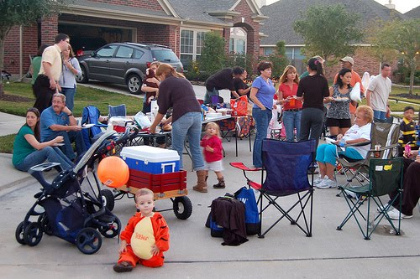
Partnership
Know your neighbors.
Vocalize your needs.
Get involved.

Slide 22
Bellevue College Trainings
Basic Preparedness
Advanced Preparedness
Incident Command System
Safety Lead
Dangerous Intruder

Slide 23
Bellevue College Exercises, Events and Drills
Lockdowns
Evacuations
Fire
Emergency Operations
Joint Exercises
Public Outreach Events

Slide 24
Bellevue College Equipment
Crisis Response Boxes
AED’s
First Aid Kits
Safety Backpacks
Fire Extinguishers
Stair Chairs
Alerts

Slide 25
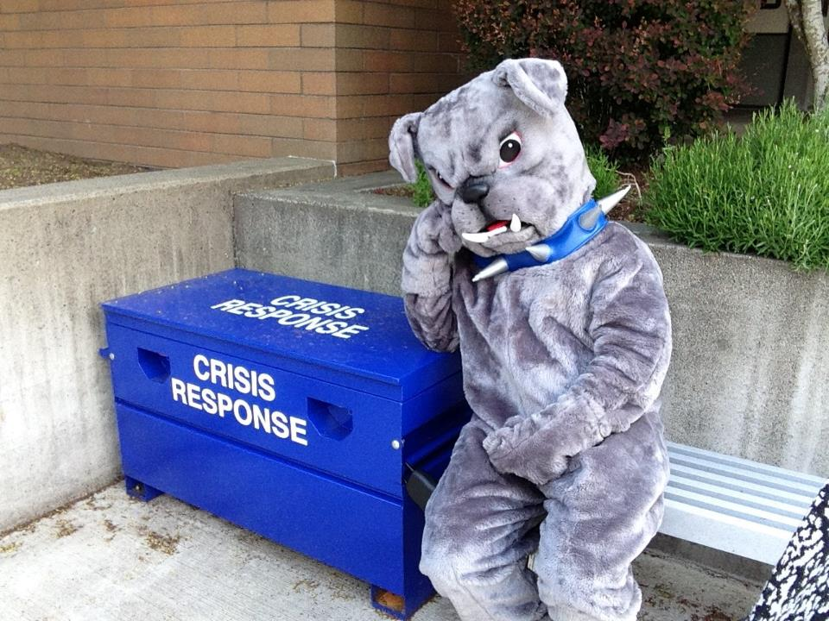

Slide 26
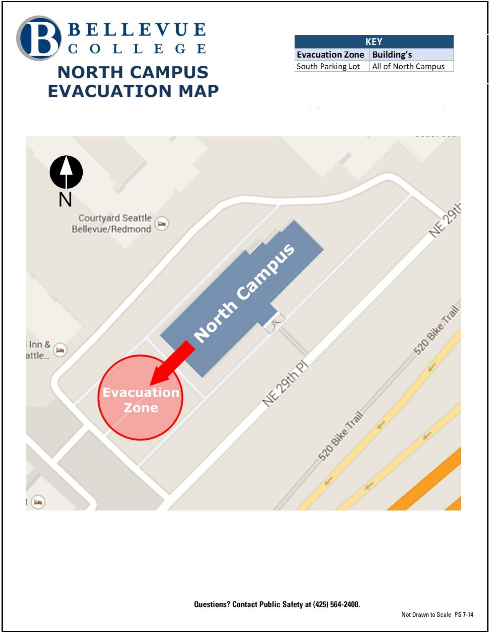

Slide 27
Partnership
  Resources:
  Community Communication Network
    http://www.kingcounty.gov/healthservices/health/preparedness/VPAT/CCN.aspx
  Ready.gov
    http://www.ready.gov/make-a-plan
    http://www.ready.gov/animals
  Puget Sound Energy
    https://pse.com/safety/GetPrepared/Pages/default.aspx
  American Red Cross
    http://www.redcross.org/safe-in-the-sound
  Make It Through
    http://makeitthrough.org/
    Build a Kit on a Shoestring Budget https://youtu.be/tSRNP8moKx0

Slide 28
Partnership
Get Started – Connect with Us
City of Bellevue OEM
  http://www.ci.bellevue.wa.us/emergency_preparedness.htm
    www.waystosurvive.org (will take you to same site as above – easier to remember) ☺
Social Media
  www.facebook.com/BellevueOEM
  www.twitter.com/BvueOEM
  www.youtube.com/BellevueOEM

Slide 29
Quote of the Day
“It is not often that a man can make opportunities for himself. But he can put himself in such shape that when or if the opportunities come he is ready.”
- Theodore Roosevelt

Slide 30
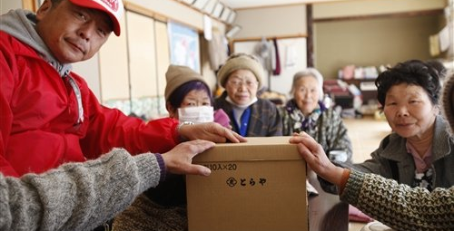
We can’t control when disasters or acts of terror happen.
What we can do is be ready -- gather together, build a culture of preparedness, and be safer as a result.

Slide 31

THANK YOU!!!!
QUESTIONS~COMMENTS~CONCERNS
  Sophia L. Lopez
  Emergency Management Coordinator
  Vulnerable Populations and Outreach
  SLopez@bellevuewa.gov
  O: (425) 452-4161

