Slide 1
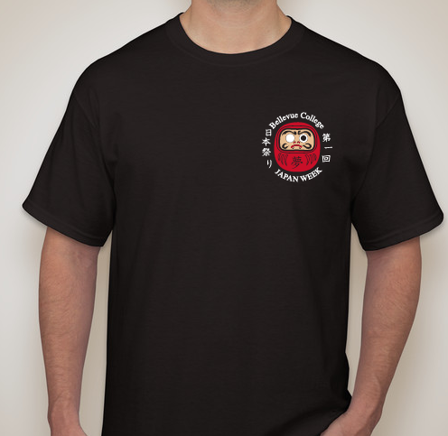

2017 Kanji: 夢 (Dream)
Front Back

Slide 2
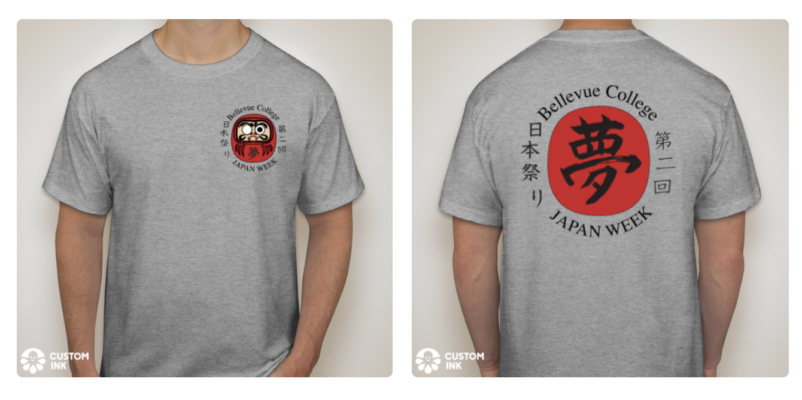
2018 Kanji: 夢 (Dream)
Front Back

Slide 3
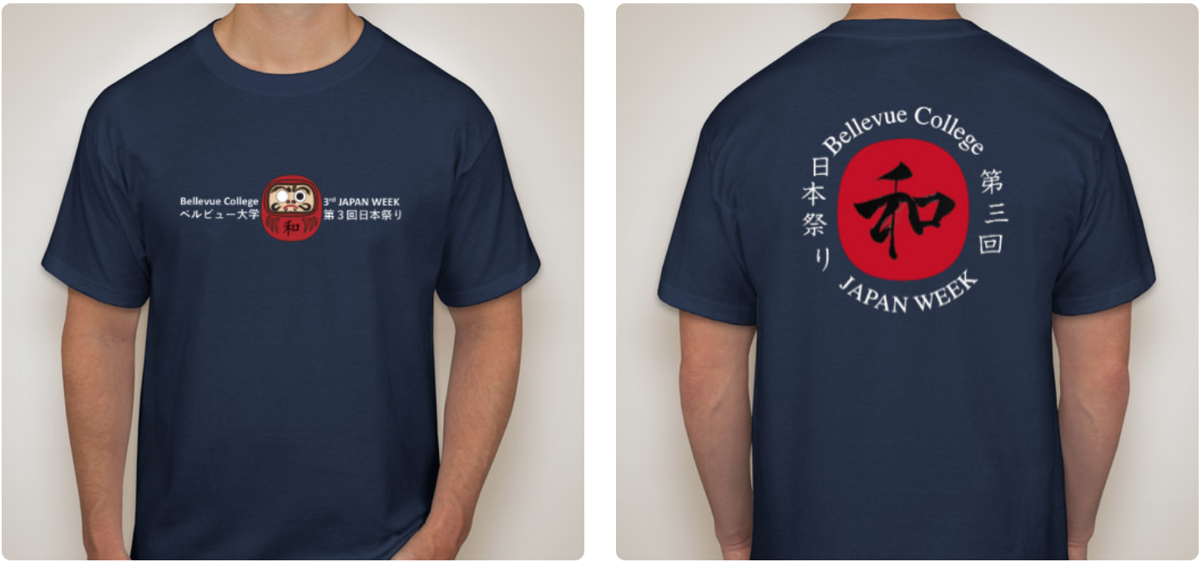
2019 Kanji: 和 (Peace, Harmony)
Front Back

Slide 4
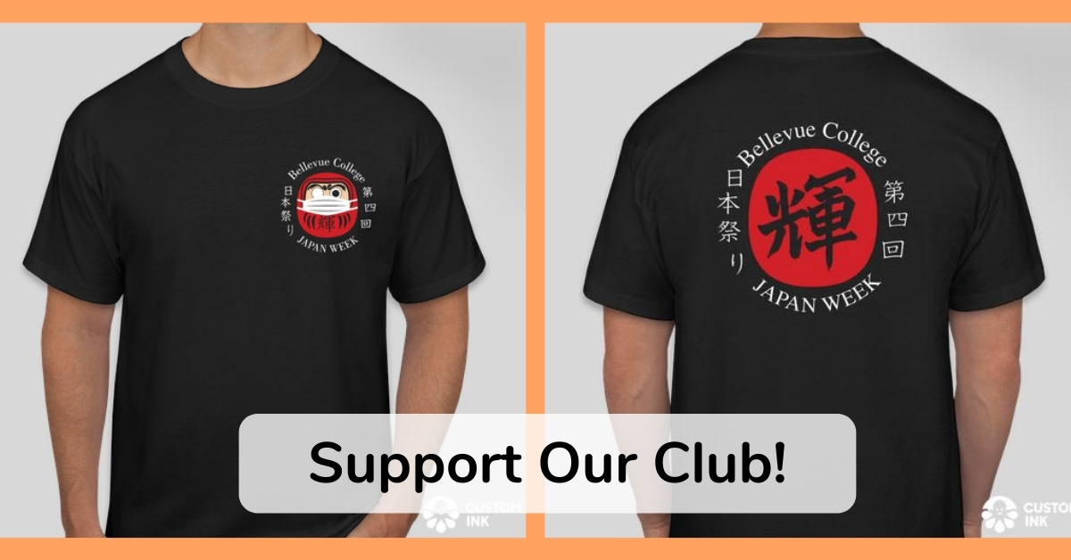
2020 Kanji: 輝 (Glow, Shine)
Front Back

Slide 5
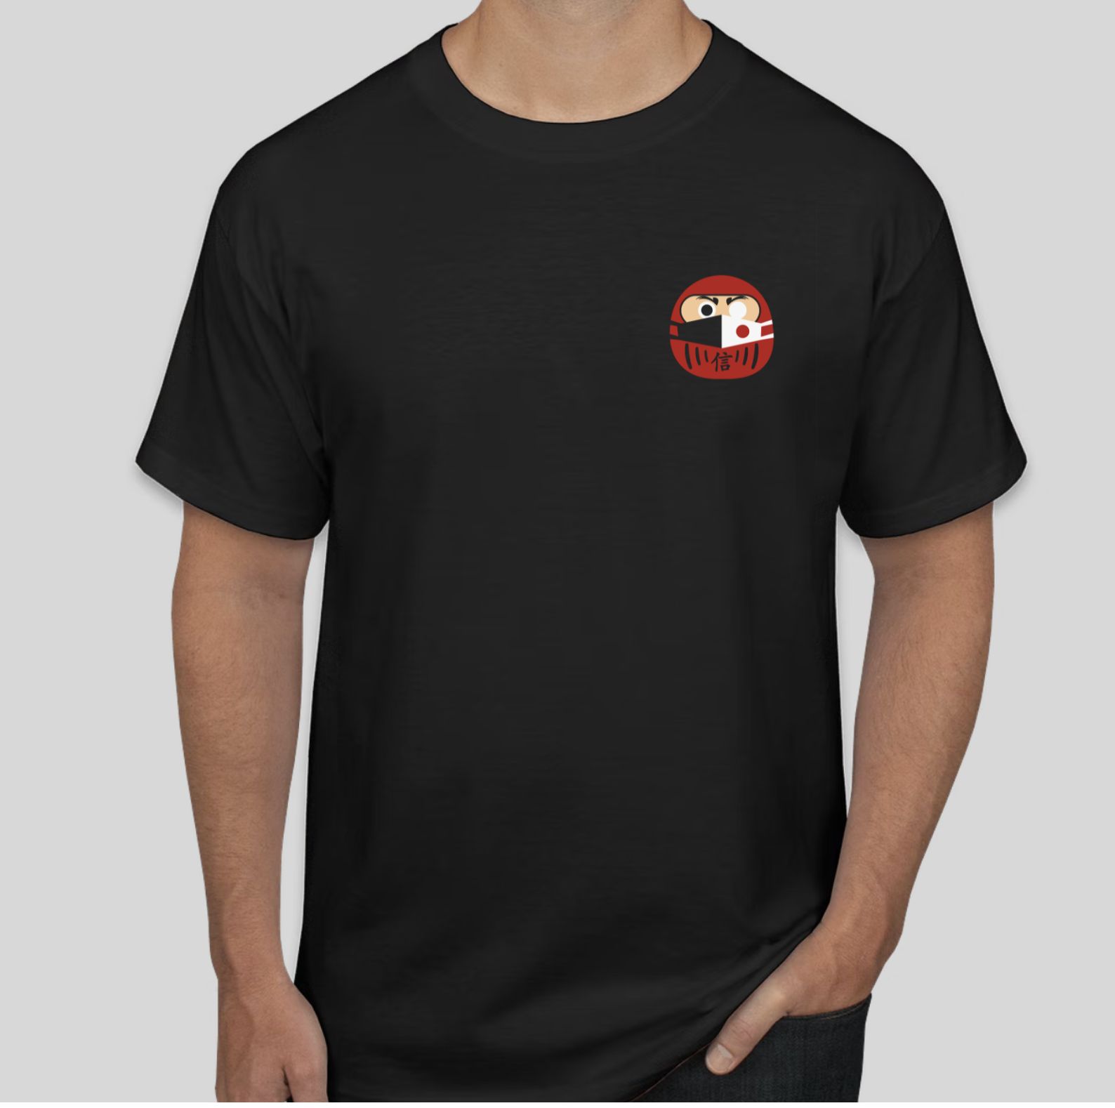

2021 Kanji: 信 (Trust, Believe)
Front Back

Slide 6
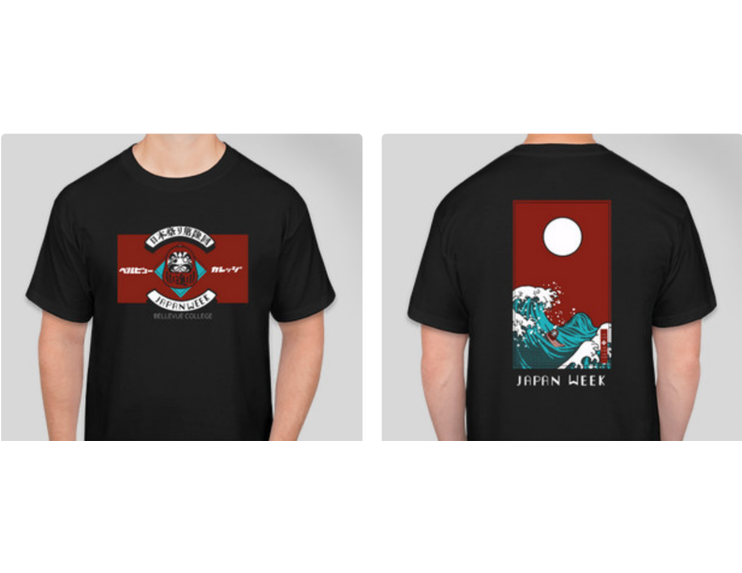
2022 Kanji: 進 (Progress, Advance)
Front Back

Slide 7

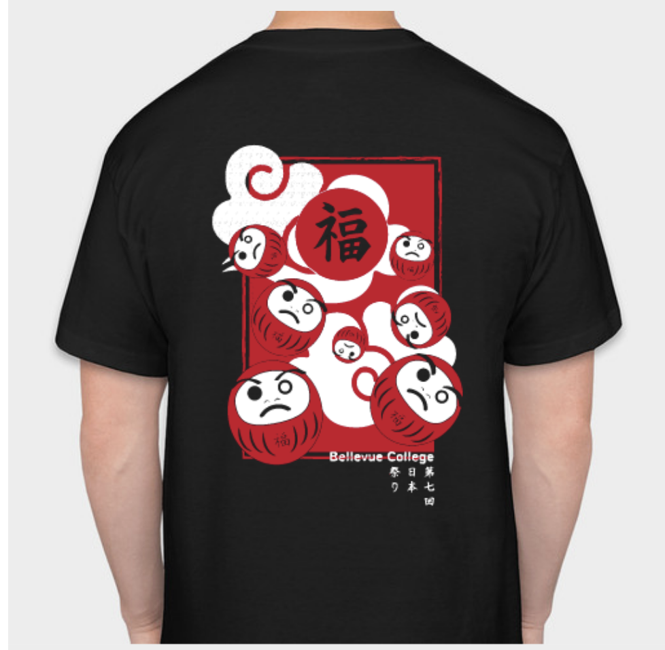
2023 Kanji: 福 (Fortune)
Front Back

Slide 8

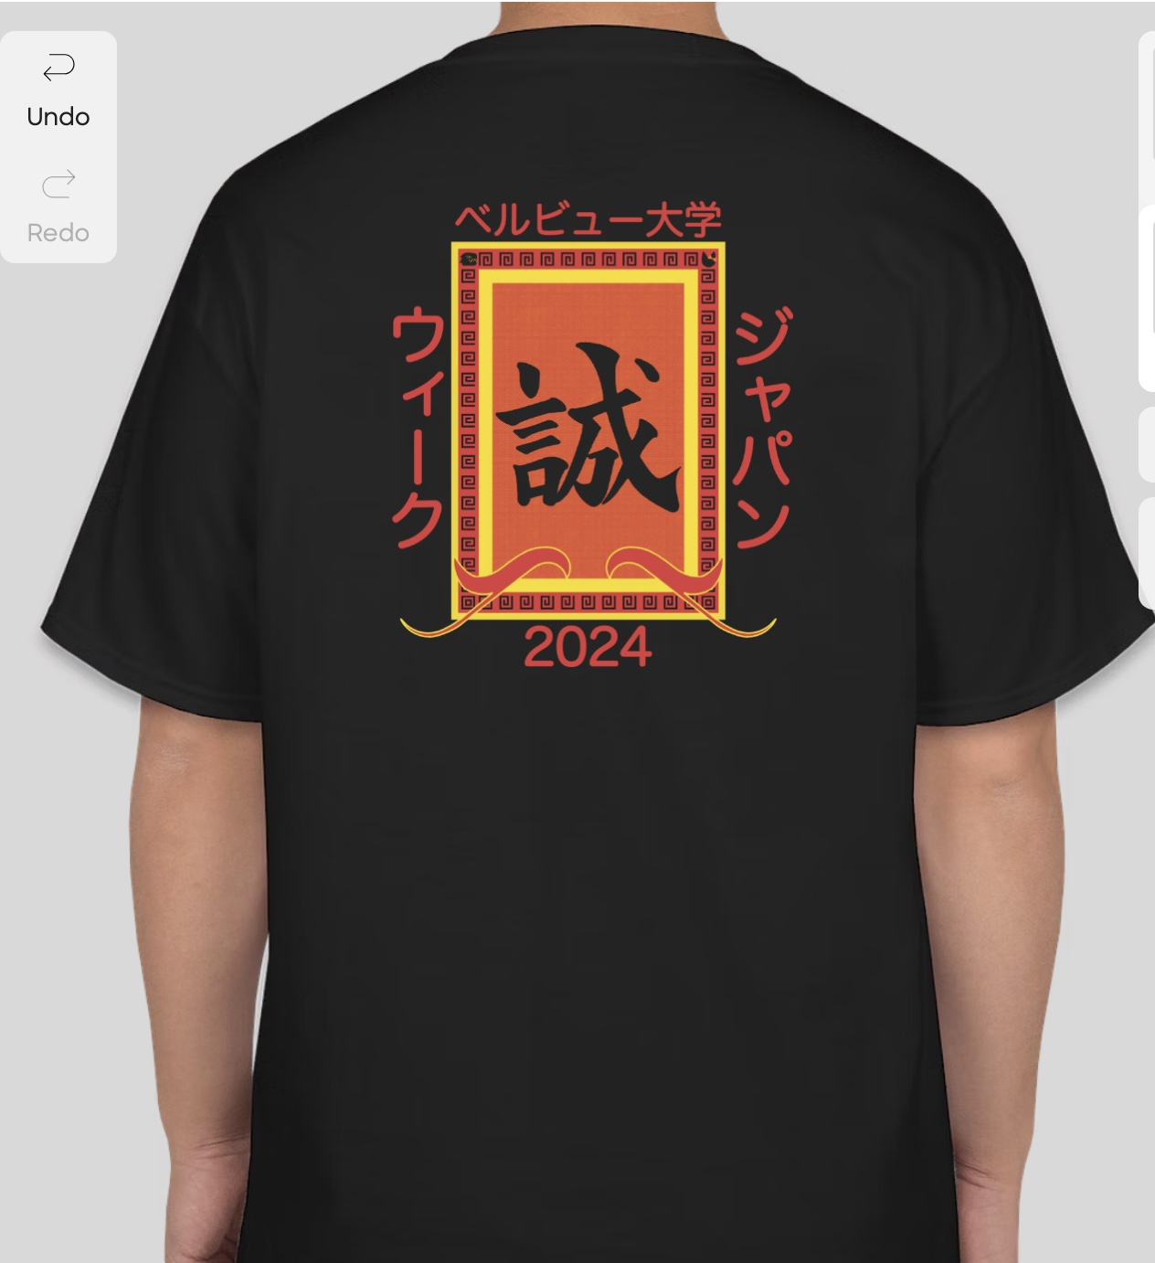
2024 Kanji: 誠 (Sincerity)
Front Back

Slide 9
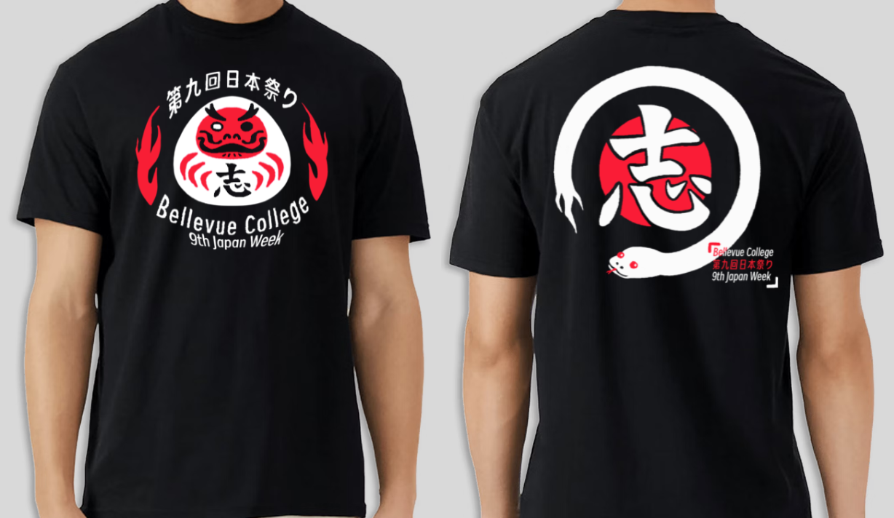
2025 JAPAN WEEK T-shirt
Front Back

Slide 10
2026 JAPAN WEEK T-shirt
Front Back
Your Design?
Your Design?

